Slide 1
2020 Living to 100 Symposium
Natalia S. Gavrilova, Leonid A. Gavrilov
Session 2C, Teaching Session: Data Validation
Date: January 13, 2020

Slide 2
Presentation Disclaimer
Presentations are intended for educational purposes only and do not replace independent professional judgment. Statements of fact and opinions expressed are those of the participants individually and, unless expressly stated to the contrary, are not the opinion or position of the Society of Actuaries, its cosponsors or its committees. The Society of Actuaries does not endorse or approve, and assumes no responsibility for, the content, accuracy or completeness of the information presented.

Slide 3
What is the quality of age reporting in the SSA Death Master File across ages and birth cohorts?
A study of data quality for five
single-year birth cohorts using direct validation method
Supported by the Society of Actuaries

Slide 4
More details are available in a special report by the Society Of Actuaries
Supported by the Society of Actuaries
https://www.soa.org/resources/research-reports/2018/birth-cohort/

Slide 5
Study Design
Five single-year birth cohorts:
1898, 1899, 1900, 1901, 1902
Direct age validation of Death Master File (DMF) samples randomly selected at ages 100, 103 and 105 years
Sample sizes: 100 records for ages 100,103,105 years
For age group 109+ years – all available records

Slide 6
Age validation procedure
Age validation was conducted by linkage of DMF records to early historical sources (U.S. censuses, birth and marriage records, draft registration cards). Data linkage was done for 2,711 records.
DMF records were scored according to reliability of age reporting. The scoring system included the following scores:
1 – several early (1950 or earlier) historical sources agree about birth date
2 – one early historical sources agrees about birth date
3 – later sources agree about birth date
Records with questionable quality:
4 – early sources disagree with DMF record
5 – foreign-born individual arrived in the U.S. later in life
6 – not found in any sources

Slide 7
Percent of records with questionable quality as a function of age. 1898, 1900 and 1902 birth cohorts
Results of age validation study for samples of 100 records, by age group.
For ages 109 and 110+ years sample sizes were slightly higher than 100.

Slide 8
Percent of records with questionable quality at extreme old ages. 1898-1902 birth cohorts

Slide 9
Regression model for percentage of poor quality records
Percentage of poor quality records is modeled as a linear function of binary (dummy) variables representing birth cohorts and ages.
where percent is percentage of poor quality records, AGE and COHORT represent sets of dummy variables (103, 105, 109 for AGE at death with 100 years used as a reference level and 1899, 1900, 1901, 1902 for COHORT birth year with 1898 used as a reference level), β₁ and β₂ are regression coefficients

Slide 10
Regression model for percentage of poor quality data
Variable | Regression coefficients | P-value | 95% confidence intervals
1898 cohort | reference
1899 cohort | 2.00 | 0.588 | -6.55 - 10.55
1900 cohort | -1.75 | 0.419 | -6.69 - 3.19
1901 cohort | -1.56e-15 | 1.000 | -8.55 - 8.55
1902 cohort | 4.75 | 0.057 | -0.19 - 9.69
Age 100 | reference
Age 103 | 4.67 | 0.092 | -1.03 - 10.37
Age 105 | 4.33 | 0.112 | -1.37 - 10.03
Age 109 | 16.67 | <0.001 | 10.97 - 22.37
Intercept | 14.33 | <0.001 | 9.40-19.27

Slide 11
Force of mortality by the data quality score 1900 birth cohort, both sexes

Slide 12
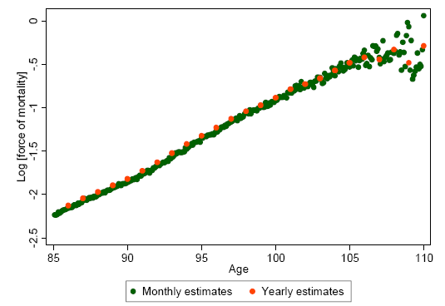
Force of mortality by monthly and yearly estimates after data cleaning 1898-1902 birth cohort, both sexes

Slide 13
Hypothesis
Mortality deceleration at advanced ages among DMF cohorts may be caused by poor data quality (age exaggeration) at very advanced ages
If this hypothesis is correct then mortality deceleration at advanced ages should be less expressed for data with better quality

Slide 14
Further development
Direct age validation of all records at ages 106 years and over for those born in 1900

Slide 15
Mortality of U.S. men and women born in 1900 depending on data quality. Age validation conducted for all records aged 106 years and over. Mortality plateau disappears for cleaner data (black circles)
Мужчины
Женщины
Men
Women
Source: Gavrilov, Gavrilova, PLOS Biology, 2019. Data Source: DMF

Slide 16
Is Mortality Deceleration Caused by Age Misreporting?
Age misstatement biases mortality estimates downwards at the oldest ages, which contributes to mortality deceleration (Preston et al., 1999).
If this hypothesis is correct then mortality deceleration should be more prevalent among historically older birth cohorts

Slide 17
Gompertz model outperforms mortality deceleration (Kannisto) model for more recent birth cohorts
Akaike information criterion (AIC) for Gompertz and Kannisto models. 40 U.S. Birth Cohorts
Source: Gavrilov, Gavrilova, Gerontology, 2019. Source of data: Human Mortality Database

Slide 18
Mortality of U.S. men and women in earlier (1881) and later (1898) birth cohorts Mortality deceleration is observed in early birth cohort only
Женщины
Мужчины
Women
Men
Source: Gavrilov, Gavrilova, Gerontology, 2019. Source of data: Human Mortality Database

Slide 19
Conclusion
Mortality deceleration is more prevalent in historically older birth cohorts when age reporting was less accurate

